Slide 1
Computer Vision
Fall 2017
Problem Set #2
Sergiy Palguyev
sergiy.palguyev@gatech.edu
Computer Vision @ GT

Slide 2

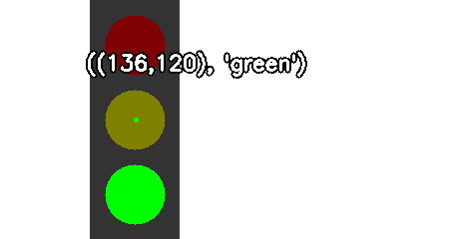
Traffic Light Detection
((136,120), ‘green’)
ps2-1-a-1.png

Slide 3
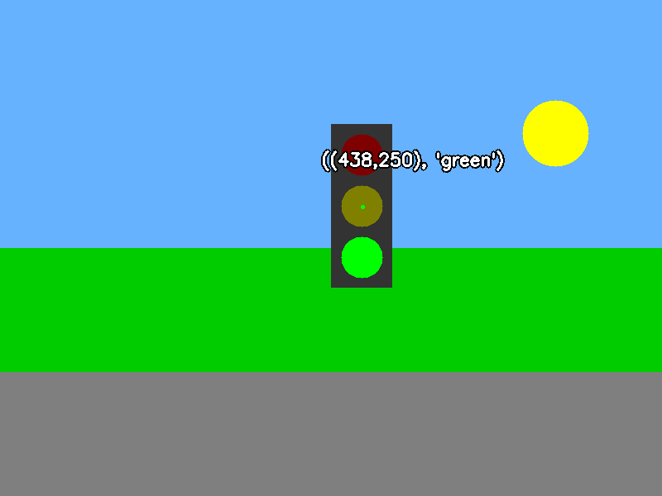
Traffic Light Detection
((438,250),’green’)
ps2-1-a-2.png

Slide 4
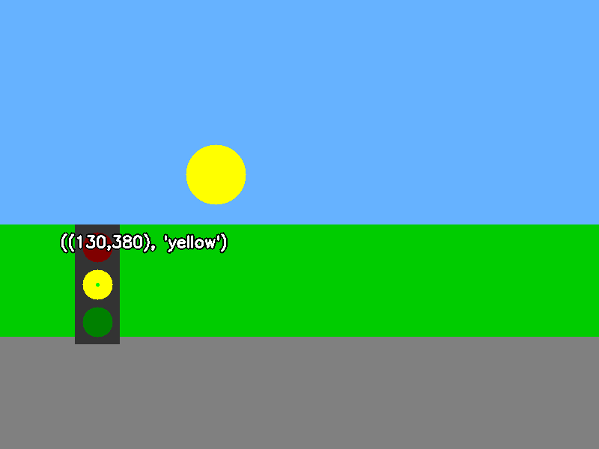
Traffic Light Detection
((130,380,’yellow’)
ps2-1-a-3.png

Slide 5

Traffic Light Detection
((630,480),’red’)
ps2-1-a-4.png

Slide 6

Traffic Sign Detection - Do not enter
(246,345)
ps2-2-a-1.png

Slide 7
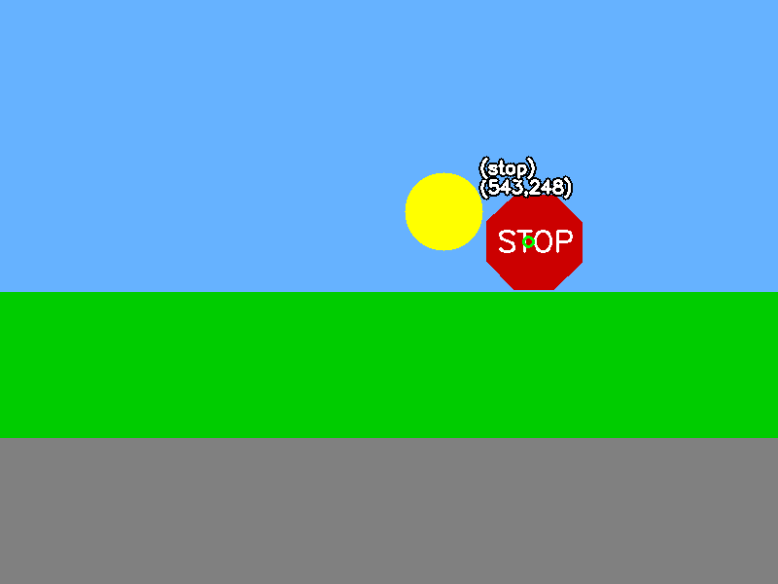
Traffic Sign Detection - Stop
(543,248)
ps2-2-a-2.png

Slide 8
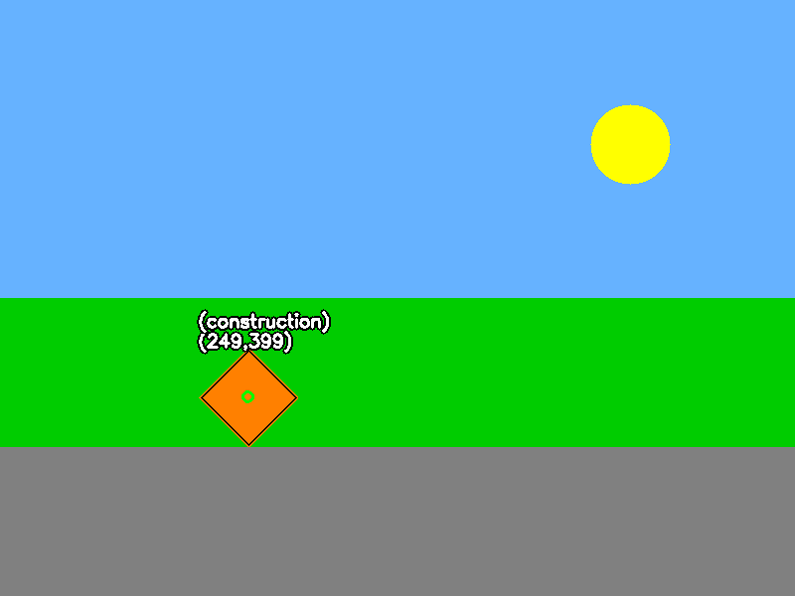
Traffic Sign Detection - Construction
(249,399)
ps2-2-a-3.png

Slide 9

Traffic Sign Detection - Warning
(749,349)
ps2-2-a-4.png

Slide 10

Traffic Sign Detection - Yield
(307,183)
ps2-2-a-5.png

Slide 11
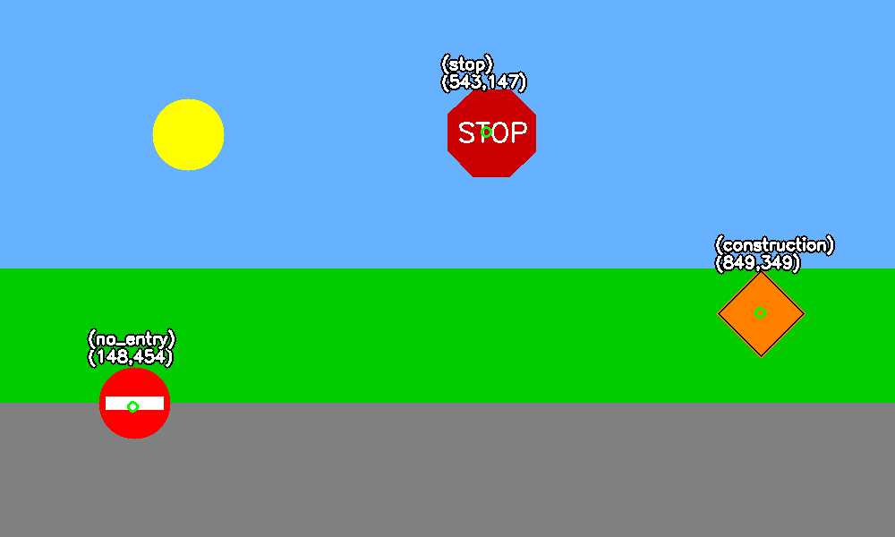
Multiple sign detection
(543,147) – stop
(148,454) – no_entry
(849,349) – construction
ps2-3-a-1.png

Slide 12
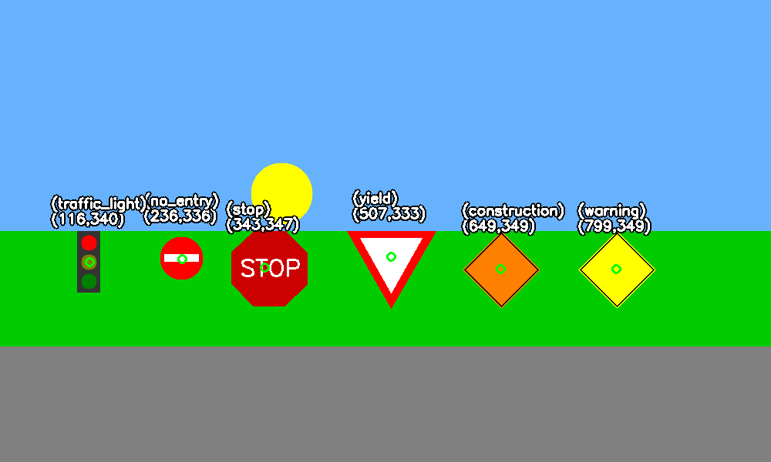
Multiple sign detection
(116,340) – traffic_light
(236,336) – no_entry
(343,347) – stop
(507,333) – yield
(649,349) – construction
(799,349) – warning
ps2-3-a-2.png

Slide 13
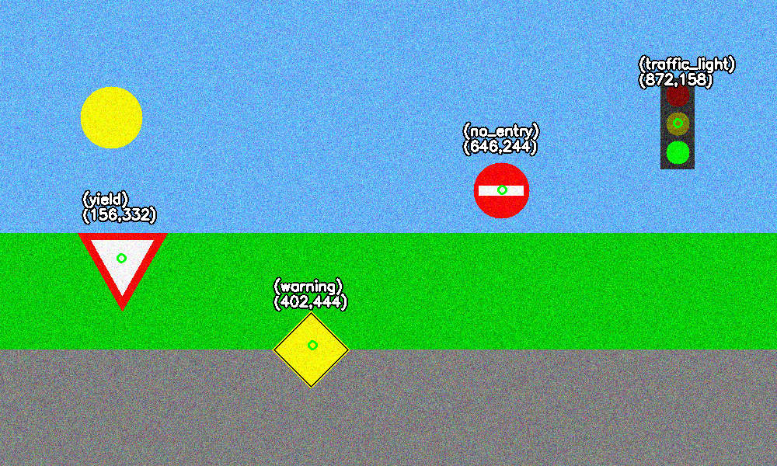
Multiple sign detection with noise
(156,332) – yield
(402,444) – warning
(646,244) – no_entry
(872,158) – traffic_light
ps2-4-a-1.png

Slide 14
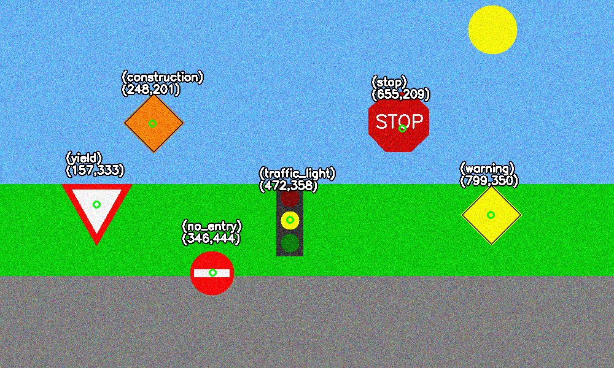
Multiple sign detection with noise
(157,333) – yield
(248,201) – construction
(346,444) – no_entry
(472,358) – traffic_light
(655,209) – stop
(799,350) – warning
ps2-4-a-2.png

Slide 15


Challenge Problem
(600,340) – construction
Input image
Output image

Slide 16
Challenge Problem
To implement real world detection, the size variance must be taken into account, as well as differences in geometry, color variation and skew of the signs.

